Slide 1
Research Methodology CS 5001 Instructor: Dr. Ramoza Ahsan

Slide 2
Agenda
Online Quiz
Project Presentations
Reasons for Paper Rejection
Writing Algorithms
Qualitative vs Quantitative Research
Questions

Slide 3
Online Quiz
Quiz link will be shared on Sunday morning.
It will be available from Sunday 3pm – Monday 11pm.
MCQs based quiz
4 mins for the quiz
8 questions
1 attempt per student
Make sure you put your full name and roll number

Slide 4
Project Presentations
Will be held from Monday 28th April –Wednesday 30th April
Each member of the group must present to get presentation marks
20 mins for each group
15 mins presentation and 5 mins for Q/A
1 member from each group should fill the slots sheet.
Slots are on first come first serve basis.
No overwriting of cells
No presentations will be taken other than these slots

Slide 5
Project Presentations
Presentation format
1 Title Slide (Paper title, student names, course name)
1-2 Introduction Slides (covering Problem, motivation, challenges)
2-4 slides covering the related works table (Paper Title, year and place of publication, Paper Idea, Strengths/ Weaknesses if any, Dataset and contribution) (No review/survey papers)
1 taxonomy slide (if applicable)
5 slides covering 5 papers (no survey paper) (1 slide per paper and each member will present 1 paper) covering paper title, year and venue of publication, Paper methodology, dataset used and results.
Conclusion
References

Slide 6
Reasons for Rejection of Papers

Slide 7
Reasons for Rejection of Reviewed Papers
Most reviewers look for reasons to reject a paper, not to accept it. Do not give them easy reasons.

Slide 8
1. Not Referencing Prior Papers by Authors
Every publication rules require every paper to be new. There is no definition of how different a paper must be to be new.
Generally, new material must be technical content, not more references and longer introduction.
However, not referencing your own work that is similar almost always results in rejection.
Using search engines, the editor or the reviewers will find prior papers by the authors

Slide 9
2. Low Novelty
Paper is very similar to prior paper by other authors.

Slide 10
3. Not State of the Art
Good publishers/venues do not publish papers that present “comparable” results.
Reviewers are experts in their fields and expect new results to be better than prior results.

Slide 11
4. Unsupported Claims
Do not make any claims that are not supported by measurements, simulations, or comparisons to prior papers.
Claims in the introduction of smaller, less memory required, less CPU time required, higher gain, etc. that are not supported will be rejected

Slide 12
5. Method not Fully Explained
A practicing engineer/researcher/developer must be able to duplicate your results based on your paper.
Give all dimensions, important equations, materials, and method details.

Slide 13
6. Poor grammar or incorrect use of English
Rules of various publishers, allow a paper to be rejected based solely on poor grammar.
Most editors will try to help authors correct grammar errors.
However, poor grammar makes the paper harder to read, so the reviewers are more likely to vote to reject the paper.

Slide 14
Writing Algorithms in the Paper

Slide 15
Writing Algorithms
In many computer science papers, the core contribution is a family of algorithms
These algorithms are often the product of months of work
the version that the researchers have decided to submit for publication is typically based on a great deal of discussion, brainstorming, prototyping, testing, analysis, and debate over details

Slide 16
Writing Algorithms - Presentation of Algorithms
You must demonstrate that the algorithm is a worthwhile contribution
Show that given appropriate input, it terminates with appropriate outcomes
Show by a combination of proof and experiment, that it meets claimed performance bound(s)
Algorithm Soundness [2]
the algorithm doesn't yield any results that are false.
If, for instance, I have a sorting algorithm that sometimes does not return a sorted list, the algorithm is not sound.
Algorithm Completeness [2]
the algorithm addresses all possible inputs and doesn't miss any.
So, if my sorting algorithm never returned an unsorted list, but simply refused to work on lists that contained a certain number, say 7, it would not be complete.

Slide 17
Writing Algorithms - Presentation of Algorithms
You must demonstrate that the algorithm is a worthwhile contribution
Algorithm correctness
In theoretical computer science, an algorithm is correct with respect to a specification if it behaves as specified.
Best explored is functional correctness, which refers to the input-output behavior of the algorithm (i.e., for each input it produces an output satisfying the specification

Slide 18
Writing Algorithms - Presentation of Algorithms
Theorem
a mathematical statement that is proved using rigorous mathematical reasoning. In a mathematical paper, the term theorem is often reserved for the most important results
Example: “Faster Compression Methods for a Weighted Graph using Locality Sensitive Hashing”
Lemma
minor result whose sole purpose is to help in proving a theorem. It is a stepping stone on the path to proving a theorem.
Example: From “SlashBurn: Graph Compression and Mining beyond Caveman Communities”

Slide 19
Writing Algorithms - Presentation of Algorithms
Describing an algorithm
The steps that make up the algorithm.
The input and output, and the internal data structures used by the algorithm.
The scope of application of the algorithm and its limitations.
The properties that will allow demonstration of correctness, which might be formally expressed as pre- and post-conditions and loop invariants,
A demonstration of correctness.
A formal analysis of cost, for both space and time requirements.
Experiments confirming the theoretical results

Slide 20
Writing Algorithms - Presentation of Algorithms
Validation by experiment is often a critical part of the presentation
experiment provides concrete evidence that, for some data, the algorithm terminates correctly and performs as predicted
Explaining a complex process
To show that it is feasible to compute a result

Slide 21
Writing Algorithms - Formalisms
List style
the algorithm is broken down into a series of numbered or named steps
This form has the advantage that the algorithm can be discussed as it is presented
Pseudocode Style
the algorithm is presented as if written in a block-structured language and each line is numbered
Pseudocode has the advantage that the structure of the algorithm is immediately obvious

Slide 22
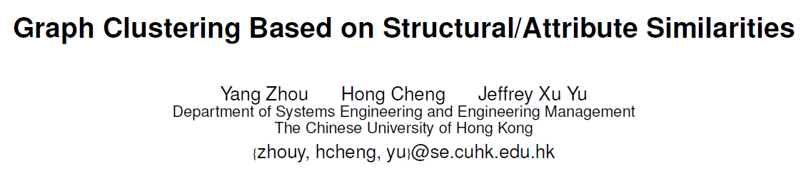
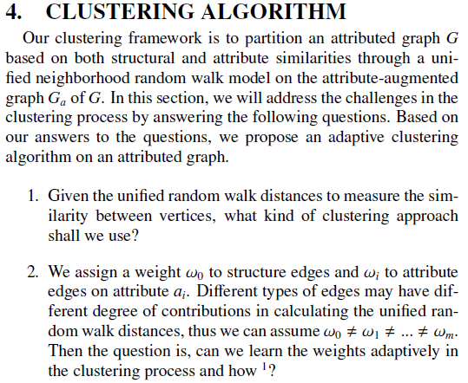
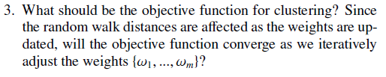
Some Examples from Literature
VLDB, 2009

Slide 23
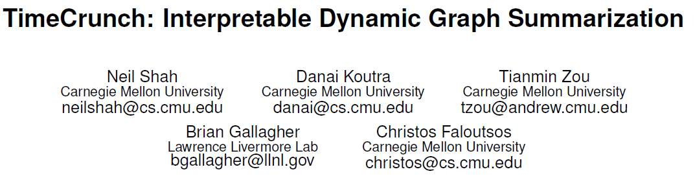
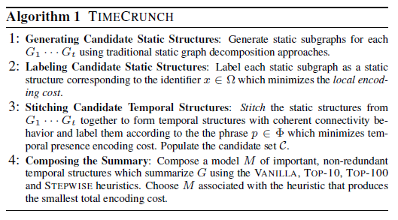
Some Examples from Literature
KDD, 2015

Slide 24
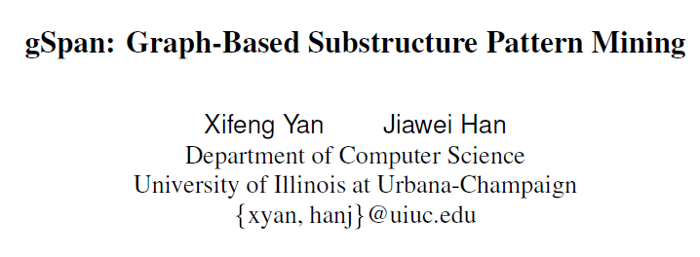
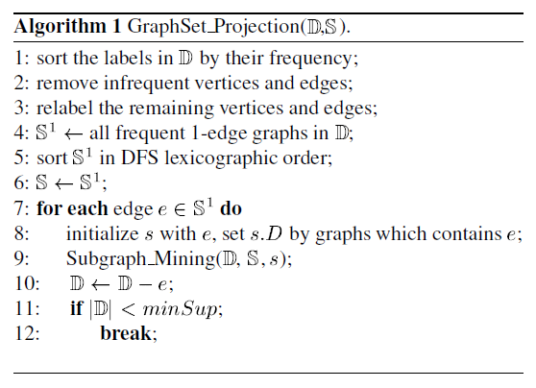
Some Examples from Literature
ICDM, 2002

Slide 25

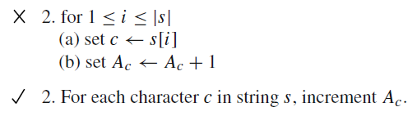
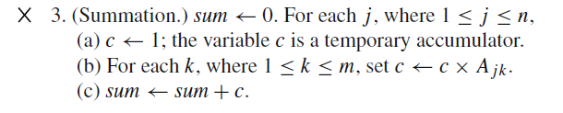
Writing Algorithms - Level of Detail
Algorithms should be specified in sufficient detail to allow them to be implemented without undue inventiveness

Slide 26
Writing Algorithms - Notation
Mathematical notation is preferable to programming notation for presentation of algorithms.
Use “x_{i} ” rather than “x[i]”, Don’t use “*” or “x” to denote multiplication -- > “×” or “·”,
Avoid using constructs from specific programming languages
expressions such as ==, a=b=0, a++, and for (i=0; i<n; i++) may have little meaning, or even the wrong meaning, to readers who are unfamiliar with C.

Slide 27
Writing Algorithms - Asymptotic Cost
The performance of algorithms is often measured by asymptotic analysis
The reader should learn how an algorithm behaves as the scale of the problem changes

Slide 28
Quantitative vs Qualitative Research

Slide 29
Quantitative vs Qualitative Research
Research methods come to two basic types: qualitative and quantitative
Quantitative (indicating that the data collected is in numerical form) and qualitative (indicating that the data collected is not in numerical form).
Often discipline determines which one:
Quantitative – the sciences, as most experimental data results in numerical data.
Qualitative – the humanities and social sciences (including law), as most data worked with is textual or informational, and not quantitative.

Slide 30
Quantitative vs Qualitative Research
Over time, the social sciences and humanities have started to include quantitative methods as well, introducing a new category called mixed methods.
This refers to a mixture of both qualitative and quantitative methods being used in the research.

Slide 31
Quantitative vs Qualitative Research
Qualitative research explores experiences and meanings through non-numerical data like interviews, and observations.
Qualitative research is interpretive (making sense of what’s happening). Most analysis is done in words
Quantitative research measures variables and tests theories using numerical data like surveys and experiments.

Slide 32
Qualitative Research
Focus: Exploring, understanding, and interpreting experiences, meanings, and perspectives.
Data: Non-numerical data like text, audio, video, and observations.
Methods: Interviews, focus groups, observations, case studies, and textual analysis.
Analysis: Interpretive, thematic, and narrative analysis.
Goal: To gain a deep understanding of a phenomenon, often in a natural setting.
Sample size: Typically smaller, focusing on in-depth exploration.
Example: Studying the lived experiences of individuals with a specific illness through interviews.

Slide 33
Quantitative Research
Focus: Measuring, quantifying, and testing relationships between variables.
Data: Numerical data that can be statistically analyzed.
Methods: Surveys, experiments, statistical analysis.
Analysis: Statistical methods like t-tests, ANOVA, and regression analysis.
Goal: To test hypotheses, establish relationships, and make predictions.
Sample size: Typically larger, allowing for generalization to a broader population.
Example: Testing the effectiveness of a new drug through a controlled experiment.

Slide 34
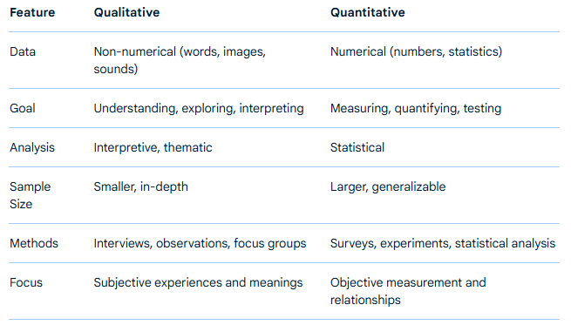
Key Differences

Slide 35
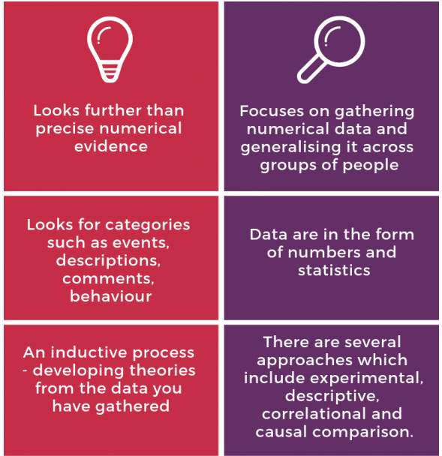

Notes:
https://blogs.sun.ac.za/libraryresearchnews/2019/01/31/research-methods-qualitative-vs-quantitative/

Slide 36
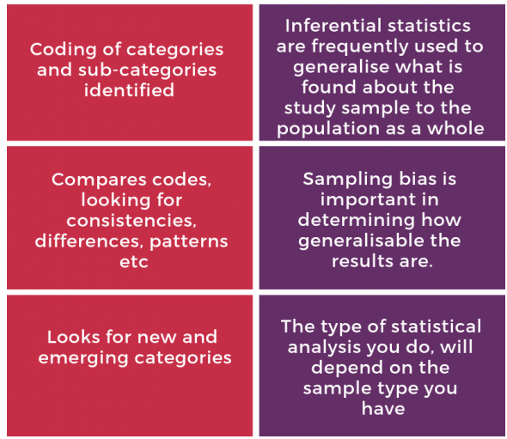
Notes:
https://blogs.sun.ac.za/libraryresearchnews/2019/01/31/research-methods-qualitative-vs-quantitative/

Slide 37
Types of Qualitative Research

Slide 38
Interviews
Generally referred to as a conversation with a purpose
Interested in gaining an individual’s interpretation of an issue
Differs from a conversation in that there is a research purpose,
a structure, a method of capturing the responses and a process for analyzing the responses

Slide 39
Focus Groups
Interviews with a group of individuals (6-8 is the optimum size)
Can be more or less structured in the format of the questioning
Facilitation of the group discussion by the researcher is key
Importance of group dynamics – both positive and negative – that effect the process
Observation of the process is as important as the spoken contribution

Slide 40
Documentary Analysis
Various types of documents produced in social life – professional records, newspaper stories, diaries.
Often intended as objective statements of fact but are socially constructed
There is the surface meaning (of what is said) and the underlying meaning (of what is intended)

Slide 41
Ethnographies
Observational field work done in the actual context being studied
Focus on how individuals interrelate in their own environment (and the influence of this environment)
Difficult to interpret/analyze
Time consuming/expensive
Can influence subject behavior

Slide 42
How to appraise Qualitative Research
Notes:
Assess the quality of research
Example: https://youtu.be/vn5qhORY7fY

Slide 43
Key Questions
Is there a clear research question being posed:
How do female victims of domestic violence make sense of the response of the police to their situation?
Is a qualitative methodology appropriate?
Is the particular qualitative method (eg interviewing, documentary analysis, observation) fit for purpose?

Slide 44
Key Questions
Has the researcher used an appropriate method and sample?
Do the findings link to the data?
Are the inferences and conclusions drawn by the researcher logical?
Have the categories of findings been appropriately constructed?
What is the degree of researcher bias and is it clear what checks have been put in place to deal with these?
What strategies have been employed to increase the credibility of the findings?

Slide 45
Questions about the sample
There is a need to ensure that the subjects being studied are appropriate to the research question:
Would you interview female victims of domestic violence or police officers?
How many individuals/groups/situations need to be studied to make the findings generalizable?
How are the participants in the research recruited and might this bias the findings:
Do you interview victims who have never contacted the police? Or only those where the police have prosecuted the perpetrator?

Slide 46
Quantitative Research
According to Aliaga and Gunderson (2000) quantitative research attempts to explain things
‘by collecting numerical data that are analyzed using mathematically based methods (in particular statistics)’.
The important distinction is that quantitative data needs to be numerical (otherwise it can’t be analyzed)

Slide 47
Quantitative Research
As such there are some questions that are particularly suited to collecting numerical data –
How many people in the population have a diagnoses of diabetes?
What is the average mark of students enrolled on post-graduate courses at QUB or Ulster?

Slide 48
Quantitative Research
There are also types of data that aren’t naturally numerical, but we can transform them e.g.
E.g. questionnaires that ask people to rate their mood on a number of statements (e.g. ‘strongly agree’, ‘agree’, ‘disagree’ or ‘strongly disagree’). Each statement may be assigned a number from 1 -4)

Slide 49
Advantages of quantitative approaches
Sometimes we need to answer population level questions (e.g. how many of those in care have experienced trauma?)
Sometimes we need to test a hypothesis (e.g. if X engaged in Y their outcomes would improve by Z%
Sometimes we need to know the link between to things (e.g. diet and disease)

Slide 50
Types of Quantitative Research

Slide 51
Survey using questionnaire
Relatively cheap to administer; if completed with a researcher can confirm or clarify questions
May restrict number of respondents; can exclude some of the population e.g. those without phones, those who can’t communicate verbally etc.

Slide 52
Existing Databases/datasets
Secondary data-relatively cheap; study can review existing large data sets
Coding may have already taken place; you are not responsible for issues around data collection

Slide 53
Experiments
An experiment is where the researcher intervenes to change something (e.g., gives some patients a drug) and then observes what happens.
Example: Researchers would randomly assign participants to either a control group (receiving a placebo) or an experimental group (receiving the drug) and then measure a specific outcome, like blood pressure readings, after a certain period. The results would be statistically analyzed to determine if the drug has a significant effect on the outcome.

Slide 54
How to appraise Quantitative Research
Is a quantitative methodology appropriate?
Is the particular quantitative method (eg experiment, survey, interviewing, database) fit for purpose?
Has the researcher used an appropriate method and sample?
Do the findings link to the data?
Are the inferences and conclusions drawn by the researcher logical?
Have the findings been appropriately analyzed?
What is the degree of researcher bias and is it clear what checks have been put in place to deal with these?
What strategies have been employed to increase the credibility of the findings?

Slide 55
Assessing Methods
Research Question(s) is/are key
Methods must answer the research question(s)
Methodology guides application
Epistemology guides analysis
All must include “rigor”
Notes:
limits of human knowledge

Slide 56
Case Scenario
Test your research savvy with the following case. Assume that you are the Mayor of Greenwood, a small town in Illinois, and you’ve got to make a decision based on the information collected from the following research study.

Slide 57
Crime Reduction Program, City of Greenwood
The chief of police wants to experiment with increasing the number of patrol officers (X) to reduce the crime rate (Y).
The chief invites all twelve area captains to participate in the experiment; only the 103rd volunteers.
In October, patrol officers in the 103rd are increased by 15%.
Reported crime drops 5% between September & December. The chief now wants to implement the program citywide.

Slide 58
You are the mayor. Would you support this request based upon the results of this study?
Could severe weather in November and December have caused the crime rate to decline?
Is crime seasonal, peaking in the summer and declining in the winter?

Slide 59
More Problems
Since the captain of the 103rd volunteered for the program, could he have already implemented other programs that account for the decline in crime?
Since the officers in the 103rd knew they were involved in a priority program, is it possible that they recorded reported crime differently?

Slide 60
More Problems
Will the crime reduction impact last very long?
Could random error in the measurement of the crime rate account for the difference?
Was the crime rate in the entire city going down anyway?

Slide 61
Sampling Methods

Slide 62
Sampling Methods
Sampling methods are ways to select a sample of data from a given population (every individual in the whole group).
It is unrealistic to collect data from the entire population because it:
is too big
takes too much time
costs too much money
We therefore take an appropriately sized sample as a way of representing the population.
Depending on the situation, some sampling methods will be more suitable than others. Whichever sampling method is used it is important to justify why that method has been used.

Slide 63
Types of Sampling Methods
1. Probability Sampling
2. Non-Probability Sampling
Notes:
https://www.geeksforgeeks.org/non-probability-sampling/

Slide 64
Probability Sampling
a method of systematic and structured sampling of a sample from a larger population in research and data analysis
makes sure that every individual or element in the population has an equal and fair opportunity to be selected in the sample
Using a strategy based on probability theory, a researcher selects samples from a broader population using probability sampling

Slide 65
Random Sampling
Every item has an equal opportunity of being picked without their being any impact on others following them.
Example: Imagine you are a quality control manager at a chocolate factory, and you want to test the quality of chocolate bars.
You assign a unique serial number to each chocolate bar, and then you use a random number generator to select 20 chocolate bars from the entire production. This ensures that each chocolate bar has an equal chance of being tested.
Notes:
The selection is like picking a name out of a hat.
Simple random sampling is the most basic and straightforward method

Slide 66
Systematic Sampling
It involves selecting every nth item from a population.
For example, if you have a list of students and you select every 10th student, that's systematic sampling.
If you are running a customer feedback program for a retail store with a daily footfall of 300 customers, you can select a systematic sample by choosing every 10th customer as they enter the store.

Slide 67
Stratified Sampling
It divides the population into subgroups or strata based on certain characteristics (e.g., age, gender), and then samples are randomly selected from each stratum
Example: Let's say you are conducting a survey on smartphone preferences. You divide the population into strata based on age groups: under 18, 18-35, and over 35. Within each stratum, you randomly select a sample of individuals.

Slide 68
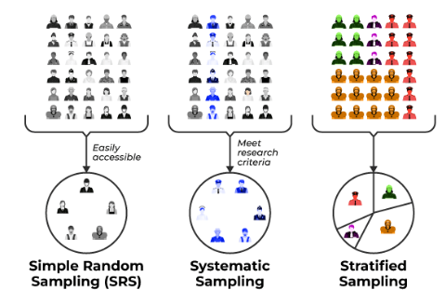
Probability Sampling

Slide 69
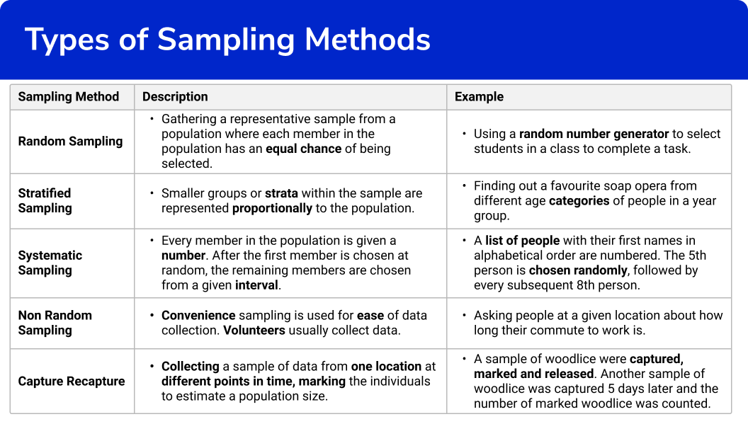

Slide 70
Benefits of Probability Sampling
Reduced bias: helps to reduce bias in the sample by ensuring that everyone has a chance of being selected.
Statistical validity: allows researchers to make inferences about the population based on the sample results.
Increased transparency: more transparent than non-probability sampling methods. This is because the selection process is based on random chance, which can be easily verified.
Ability to calculate sampling error: allows researchers to calculate the sampling error, which is the difference between the sample results and the population results. This information can be used to determine the confidence level of the results.
Increased confidence in results: researchers can be more confident that their results are accurate and can be generalized to the population as a whole.
Notes:
This is especially important when the population is large and diverse.

Slide 71
Non-probabilistic Sampling
Non-probability sampling is a method of selecting a pattern from a population in a manner that does not involve random choice.
depend on subjective judgment, convenience, or different non-random strategies to pick participants
usually used in conditions where random sampling can be tough, impractical, or high-priced, consisting of qualitative studies
can introduce bias into the sample
Notes:
https://www.geeksforgeeks.org/non-probability-sampling/

Slide 72
Convenience sampling (or haphazard sampling)
Researchers choose members based on their accessibility and proximity, making it convenient to collect information
For example, surveying humans at a shopping center or a nearby park would be considered a convenience pattern.
While this method is simple to implement, it frequently outcomes in a biased sample, as it may not represent the complete population.

Slide 73
Judgmental or Purposive Sampling
researchers handpick individuals who they consider are the maximum applicable or knowledgeable approximately the study topic
frequently utilized in qualitative studies
can introduce researcher bias and may not be appropriate for generalization.
Example: Suppose a researcher is conducting a study on the performance of top-performing employee in a big company. Instead of choosing employee randomly, the researcher chooses to interview employee who have acquired a couple of awards and recognitions for their terrific work.

Slide 74
Snowball Sampling
usually used while the target population is hard to reach, which include hidden or marginalized communities.
A researcher begins with some initial individuals after which asks them to refer others who match the studies standards
valuable for analyzing small, elusive populations however may suffer from chain-referral bias

Slide 75
Quota Sampling
entails dividing the population into subgroups or strata and then putting a quota for each subgroup
Researchers acquire records from individuals within every subgroup till the quota is met
it does not assure representativeness and can lead to selection bias if the quotas are not carefully designed

Slide 76
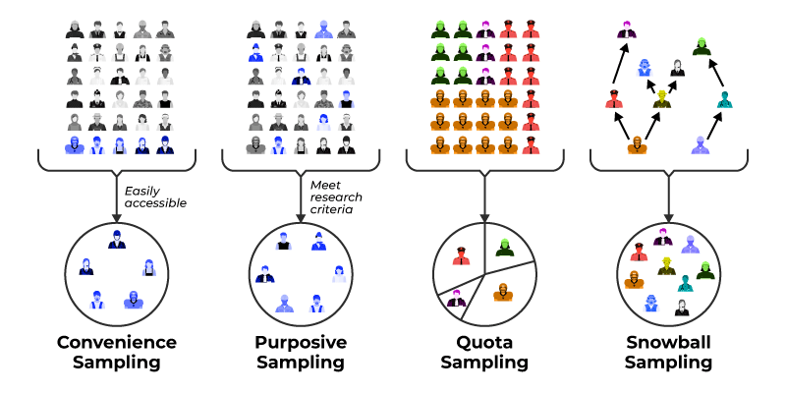
Non-probabilistic Sampling

Slide 77
Limitations of Non-Probability Sampling
Bias: Often introduce choice bias, because the sample may not correctly replicate the characteristics of the whole population.
Limited Generalizability: Findings might not be generalized to the wider population, making them less suitable for making population-level inferences.
Subjectivity: It is based on the researcher's judgment and restraint, that could introduce researcher bias into the pattern selection process.
Unknown Error Rates: Unlike probability sampling, which provides known errors rates, non-probability sampling lacks a clear framework for quantifying and controlling errors.

Slide 78
Thank you
Questions?

